Slide 1
METAvivor Research Grant Applicant Training 2025

Slide 2
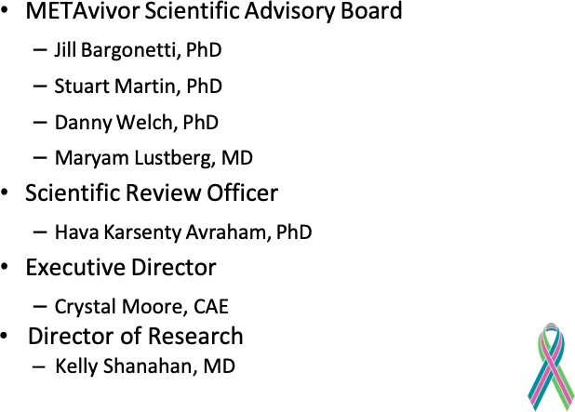

Slide 4
Scientific Advisory Board – Tips for Submitting A Successful Grant
Grant responsive to RFA
Scope is reasonable for time/budget
CLEAR, well-defined hypothesis
LOS are included (reagents, etc.)
High risk okay, but explain how risk mitigated
Advocate involvement not superficial (token LOS is not enough!)
Plan for R01 isn’t perfunctory
Assume something will go wrong at submission – plan ahead!
Proofread the final product CAREFULLY

Slide 5
METAvivor Research Program
Since 2009, METAvivor has awarded 218 research grants totaling $37,250,000. METAvivor is the only national organization with a peer and patient advocate reviewed grant program aimed at exclusively funding MBC research. 90% of all donations are directed to the research awards.
MBC-specific research program – NOT prevention of metastasis!
Amounts and categories may vary by grant cycle
2025 MBC Research Cycle will feature three awards:
Early Career $200,000 – Two-year award
Translational $450,000 – Three-year award
Quality of Life $200,000 – Two-year award

Slide 6
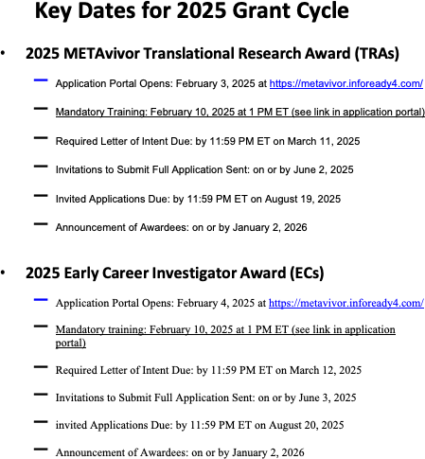

Slide 7
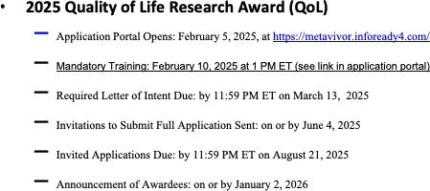

Slide 8
2025 Translational Research Award
METAvivor is offering awards of up to $450,000 (total) over three years for translational and clinical research designed to address critical problems or barriers to progress in the field of MBC.
This amount includes direct costs (including up to $4500 over three years for travel), and indirect costs of up to 5% of the total award
Applicants must hold a PhD, MD, DVM or equivalent doctoral degree from an accredited institution and must hold an independent position beyond the level of a trainee (i.e., postdoctoral fellow, student, clinical fellow, resident, etc.) in the United States.
We anticipate that approximately 30% of early career applicants that submit the required Letter of Intent (LOI) will be invited to submit a full application following the LOI review process.
Only invited applications will be considered for funding.

Slide 9
2025 Early Career Investigator Award
METAvivor is offering awards of up to $200,000 (total) over two years to early career investigators (investigators within 10 years of their professional degree award date and within 6 years of starting their first non-tenured faculty position if they have started one, see eligibility in the RFP).
This amount includes direct costs (including up to $3000 over two years for travel), and indirect costs of up to 5% of the total award. Applicants must hold a PhD, MD, DVM or equivalent doctoral degree from an accredited institution and must hold an independent position beyond the level of a trainee (i.e., postdoctoral fellow, student, clinical fellow, resident, etc.) in the United States.
We anticipate that approximately 30% of early career applicants that submit the required Letter of Intent (LOI) will be invited to submit a full application following the LOI review process.
Only invited applications will be considered for funding.

Slide 10
2025 Quality of Life Research Award
METAvivor is offering awards of up to $200,000 (total) over two years for quality of life researchers to provide a supporting foundation for translational and clinical research designed to improve quality of life and/or mitigate side effects of those living with metastatic breast cancer.
This amount includes direct costs (including up to $3000 over two years for travel), and indirect costs of up to 5% of the total award.
Applicants must hold a PhD, MD, DVM or equivalent doctoral degree from an accredited institution and must hold an independent position beyond the level of a trainee (i.e., postdoctoral fellow, student, clinical fellow, resident, etc.) in the United States.
We anticipate that approximately 30% of applicants that submit the required Letter of Intent (LOI) will be invited to submit a full application following the LOI review process.
Only invited applications will be considered for funding

Slide 12
Peer Review Process
Reviewers are critical to our mission to ensure that METAvivor grant applications receive, fair, independent, expert, and timely reviews.
METAvivor uses a two-step review process for evaluating applications, with both steps involving dynamic interaction between scientists and disease survivors (Patient Advocate Reviewers (PARs).
The first step of evaluation is a scientific and patient advocate peer review of the Letter of Intent applications (LOIs), measured against established criteria for determining scientific merit.
The second step is a full grant application review by leading scientists, clinicians, and PARs.
The recommendations for funding are based on scientific merit, potential impact, adherence to the intent of the award mechanism relevance to METAvivor goals

Slide 13
How Letters of Intent (LOI) and Invited Grants are Scored
A scale of 1 through 9 will be utilized with 1 being the maximum possible impact for patients:
1-3 Very strong, maximum possible impact for patients (most competitive applications score in this range)
4-6 Average, moderate impact (might be a good application but not quite as compelling in terms of impact)
7-9 Weak, low Impact
Every LOI and grant is reviewed by 1-2 scientific reviewers and 1-2 patient advocate reviewers (PARs). The PARs review for overall impact only and their scores are averaged with the scientific reviewer impact scores.

Slide 14
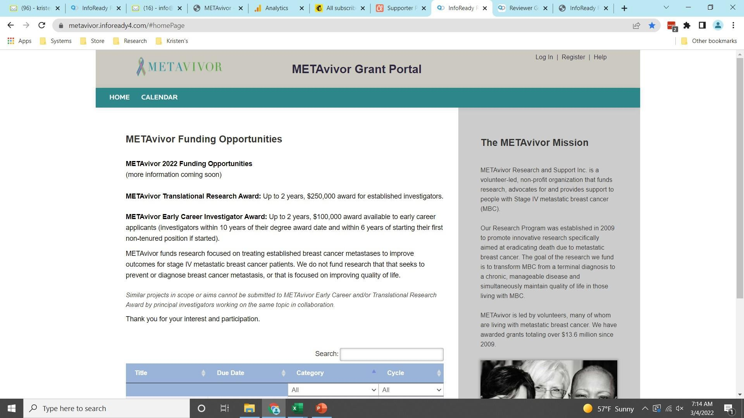
How To Access InfoReady for Review
STEP 1
Go to
https://metavivor.infoready4.com/#homePage to get started
Upper right- hand corner, click on “REGISTER”

Slide 15
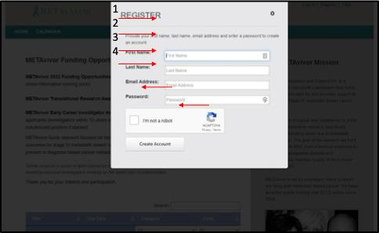
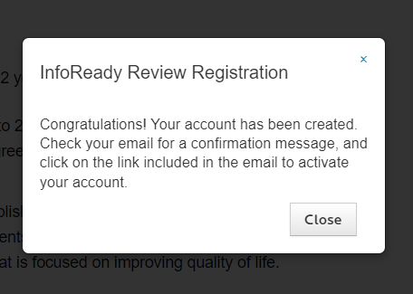
STEP 2
Fill in your personal information including your email address and create a password
A confirmation will appear and direct you to your email to continue

Slide 16
STEP 3
In the email account you registered with, you will receive this email.
Click “CONFIRM ACCOUNT”

Slide 17
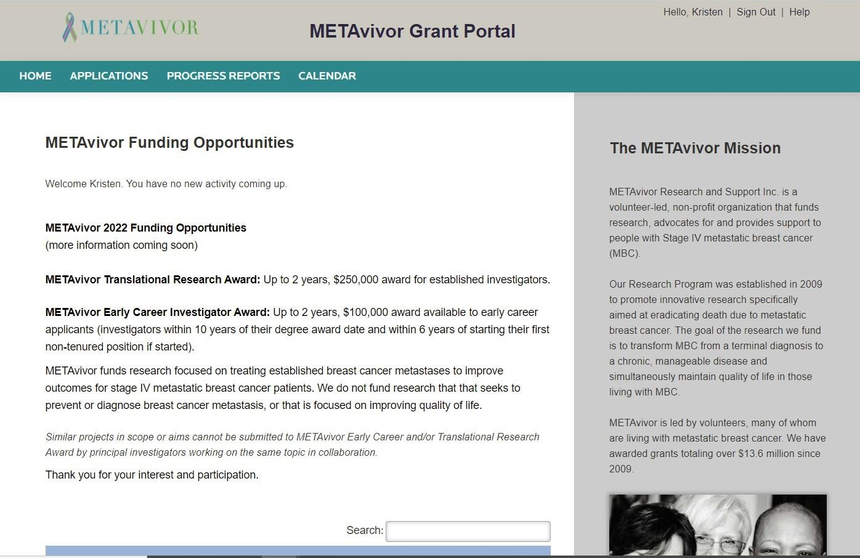
STEP 4
Once confirmed, you
will be taken to this page (already signed in).
InfoReady has an extensive “help” section for reviewers, including a downloadable guide. https://infoready.freshdes k.com/support/solutions/ 14000072814

Slide 18
Tips for Successful LOIs and Grant Applications
METAvivor funds research focused on treating established breast cancer metastases to improve outcomes for stage IV metastatic breast cancer patients.
Strong LOIs must have a clear focus on studying established breast cancer metastases throughout.
Preference for funding will be given to research with potential to lead directly to improved clinical outcomes (clinical studies), or that is meant to provide a clear conceptual foundation for improving the treatment of metastatic breast cancer in the future, as in the case of mechanistic or basic studies for example.
All full applications require inclusion of a patient advocate. Advocate involvement must be meaningful; examples of meaningful involvement include advocates reviewing the lay summary, helping to refine hypotheses that are meaningful to patients, being invited to lab meetings

Slide 19
THANK YOU AND QUESTIONS

